Slide 1
Practical Exercise

Slide 2
Activity Overview
This exercise involves editing MATLAB code, running the code, and comparing the fit and forecasting performance of a standard SEIR model against other phenomenological growth models (i.e., generalized growth model) using data from the first wave of the mpox in the United States.
This exercise will provide:
Hands-on experience with the QuantDiffForecast toolbox
Practice with the methods discussed throughout today’s lectures.
Goal
To determine the best approach, using the provided SEIR model, to fit and forecast the 2022-2023 epidemic in the United States employing the tools covered today.

Slide 3
2022-2023 Mpox Epidemic
In May 2022, an unprecedent, epidemiologically unique, surge in mpox cases was observed around the globe
Transmission
Symptomology
Impacted Communities
Over 94,584 cases and 163 deaths reported worldwide in non-endemic regions (June 30th, 2024)
Highest impacted countries: Brazil, Canada, France, Germany, Spain, the United Kingdom, and the United States
UN News., Monkeypox declared a. 2022; Philpott, D. et al., MMWR. 2022; CDC. About mpox. 2023; CDC. 2022 mpox outbreak. 2022.

Slide 5


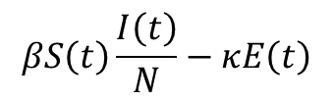
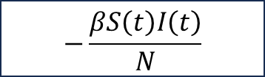
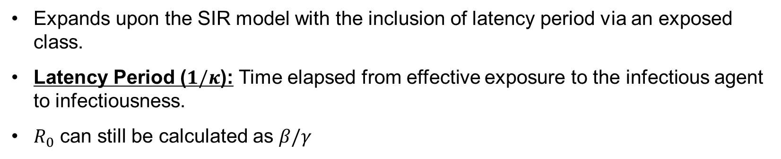
Susceptible-Exposed-Infectious-Recovered model
S
E
I
R
$$−\frac{βS\left(t\right)I\left(t\right)}{N}$$
$$βS\left(t\right)\frac{I\left(t\right)}{N}−κE\left(t\right)$$
$$κE\left(t\right)−γI\left(t\right)$$
$$γI\left(t\right)$$
Expands upon the SIR model with the inclusion of latency period via an exposed class.
Latency Period ($1/κ$): Time elapsed from effective exposure to the infectious agent to infectiousness.
$R_{0}$ can still be calculated as $β/γ$

Slide 6
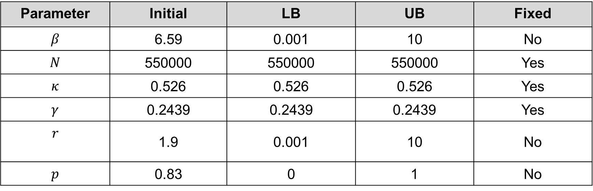
Parameters
Parameter | Initial | LB | UB | Fixed
$$β$$ | 6.59 | 0.001 | 10 | No
$$N$$ | 550000 | 550000 | 550000 | Yes
$$κ$$ | 0.526 | 0.526 | 0.526 | Yes
$$γ$$ | 0.2439 | 0.2439 | 0.2439 | Yes
$$r$$ | 1.9 | 0.001 | 10 | No
$$p$$ | 0.83 | 0 | 1 | No

Slide 7
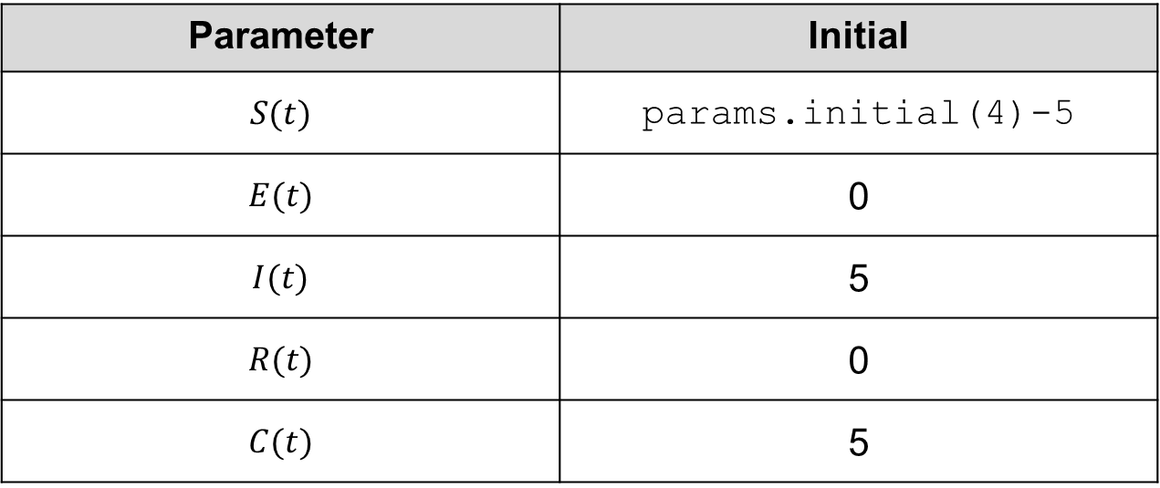
Initial Conditions
Parameter | Initial
$$S(t)$$ | params.initial(4)-5
$$E(t)$$ | 0
$$I(t)$$ | 5
$$R(t)$$ | 0
$$C(t)$$ | 5

Slide 8
Additional Specifications
Model: Susceptible-Infectious-Recovered, Neg. Binomial Distribution
Comparison Models: Generalized Growth Model (GGM)
Forecasting Dates:
2022-07-14 (Use 11-weeks calibration period)
2023-02-23 (Use all data for calibration)
Forecasting Horizon: 4-weeks
Calibration period length:
Weekly: 11-weeks and All data
Bootstrapping: Use between 100-300 samples, set start points to 10
Using this information, and the parameters provided on other slides, prepare the options_fit.m files and conduct a model comparison analysis.

Slide 9
Comparing Models: Example Table
Model | MAE | MSE | Coverage 95% PI | WIS
Calibration Performance
Forecast Performance

Slide 10
Questions
(1) Which model would you use to fit the early phase of the mpox epidemic?
(2) Which model would you use to forecast during the early phase of the mpox epidemic?
(3) Which model would you use to fit the entire mpox epidemic curve?
(4) Which model would you use to forecast 4-weeks into the future, calibrating the model with all available weeks of data?
Please submit your responses on the course website.

